Slide 1




SEE-U : “REAL-TIME OBJECT
DETECTION AND DISTANCE
ESTIMATION APP FOR ASSISTING
THE VISUALLY IMPAIRED”
Presented by Jaivik J. Rathod

Slide 2
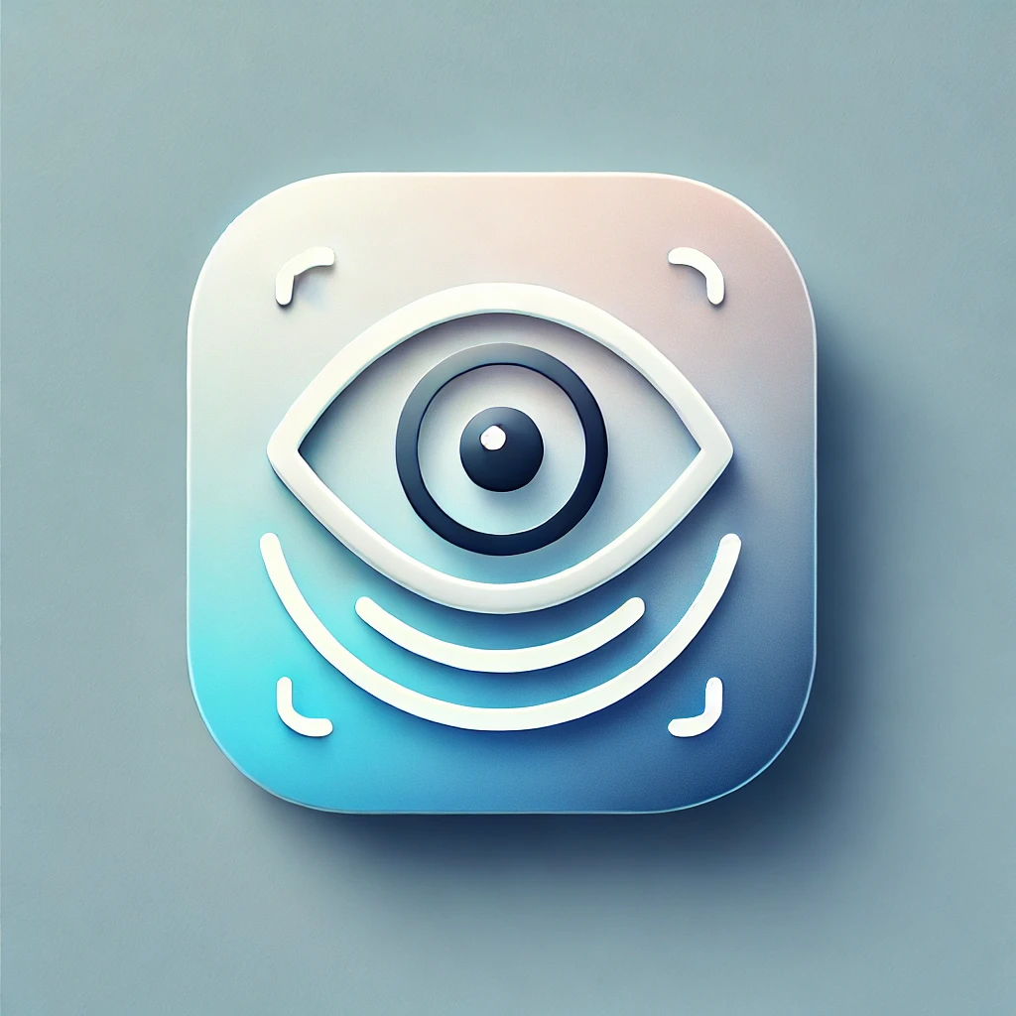
PROJECT DEFINITION
Develop a smartphone app that uses AI to detect objects, estimate distances, and assist users through auditory feedback.
The app also include a two-way communication so user can ask question also.

Slide 3
OBJECTIVE & TECHNOLOGY
Objective: To create an AI-powered app that enables visually impaired individuals to navigate their surroundings more safely and confidently.
Key Features:
Real-time object detection.
Distance estimation.
LLM response.
Feedback via audio.
Technology Stack:
AI Models: YOLOv8 for object detection, MiDaS for depth estimation.
Programming Languages: Python,Dart
Frameworks: PyTorch, OpenCV.

Slide 4
SCOPE
The scope of this project encompasses the development and implementation of a mobile application designed to assist visually impaired individuals through advanced object detection and distance estimation features.
Key aspects within the scope include:
Object Detection: Integration of machine learning algorithms to accurately identify common objects in the user's environment.
Distance Estimation: Utilizing depth perception technologies to estimate the distance between the user and detected objects.
TTS Feedback: Implementation of a user-friendly interface that delivers auditory cues to inform users about nearby obstacles and objects.

Slide 5
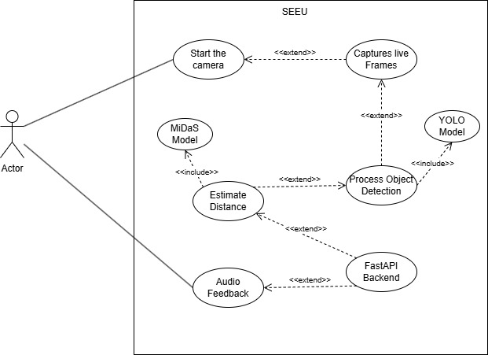
SRS- Use Case Diagram

Slide 6
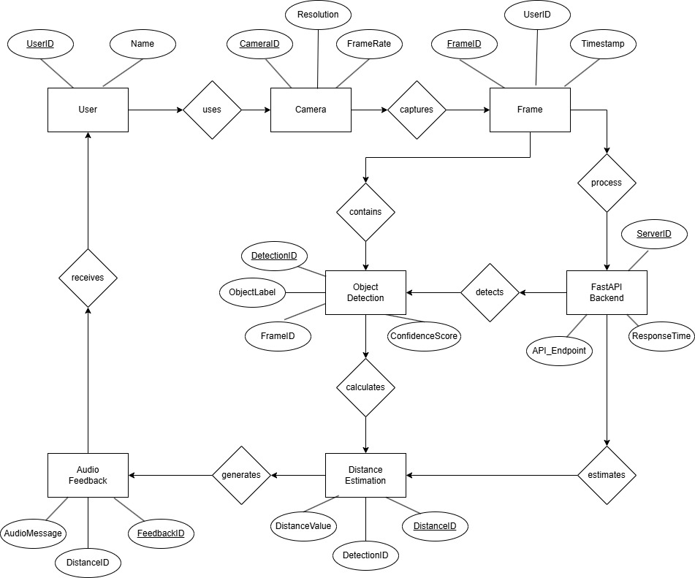
SRS- E-R Diagram

Slide 7
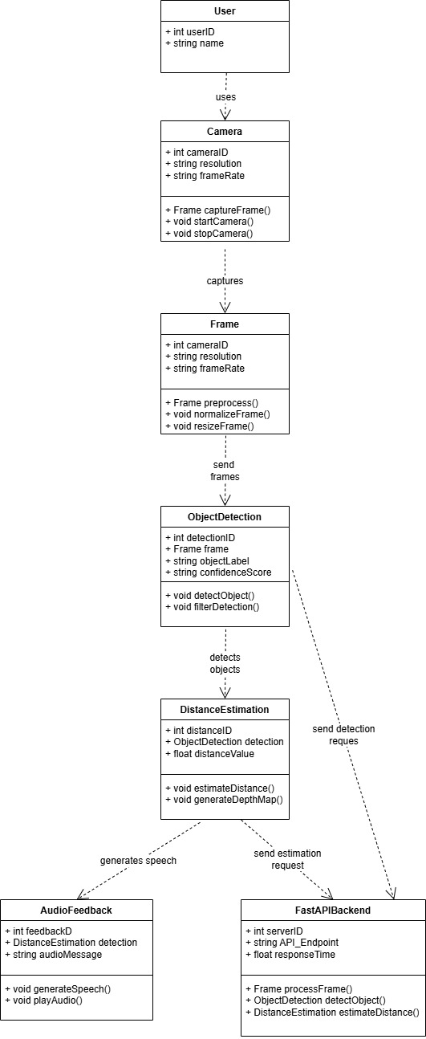
SRS-
Class Diagram

Slide 8
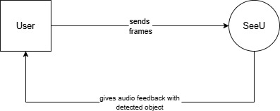
SRS- DFD Level 0

Slide 9
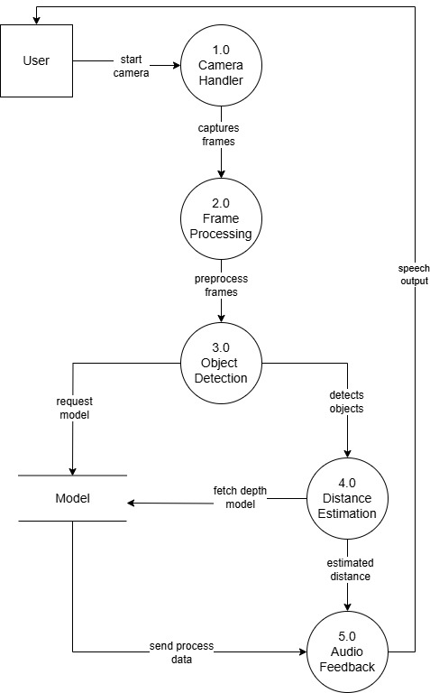
SRS-
DFD Level 1

Slide 10
MODULE OVERVIEW
Object Detection Module
2. Depth Estimation Module
3. Distance Calculation Module
4. LLM Response Module
5. Feedback Module

Slide 11
OBJECT DETECTION MODULE
Purpose : To detect objects in real-time.
Technology: YOLOv8 (custom-trained besttrain.pt)
Process Flow :
Camera → Frame Capture → Preprocess (OpenCV) → YOLO Inference → Filter (conf > 0.3) → Output Bounding Boxes.
Key parameters :
Conf = 0.3 : Confidence threshold(tuned for precision)
Iou=0.5 : Non-max suppression to merge overlaps
Performance :
92% mAP@0.5 on custom dataset.

Slide 12
Table of Detected Object
person | skateboard | keyboard | apple | surfboard | couch | clock | backpack
car | bear | microwave | umbrella | toaster | banana | dining table | wine glass
dog | sheep | kite | hot dog | bowl | tennis racket | tie | traffic light
laptop | airplane | spoon | chair | mouse | potted plant | boat | sandwich
scissors | giraffe | pizza | zebra | bird | sink | book | stop sign
cat | bottle | oven | refrigerator | TV | sports ball | remote | train
teddy bear | couch | cell phone | bed | orange | elephant | handbag | fire hydrant
horse | snowboard | truck | fork | baseball bat | motorcycle | knife | broccoli
frisbee | keyboard | donut | kite | dining table | baseball glove | bench | toothbrush
vase | suitcase | cow | airplane | toaster | book | sink | Tie
speaker | shoes | keys

Slide 13
DEPTH ESTIMATION MODULE
Purpose : To generate depth maps and estimate the relative distance of objects from the camera.
Technology: MiDaS (PyTorch)
Process Flow:
RGB Frame → MiDaS Small Transform → Depth Map → Crop to Bounding Box → Avg. Depth per Object
Calibration:
CALIBRATION_FACTOR = 114

Slide 14
DISTANCE CALCULATION MODULE
Purpose : To calculate the actual distance of objects using the pinhole camera formula.
Formula :
distance = CALIBRATION_FACTOR / avg_depth
Where avg_depth is from MiDaS.
Integration :
Combines YOLO bbox + MiDaS depth map.
Output : {“object” : “chair”, “distance”: 0.26}.
Accuracy: ±0.3m error within 5m range.

Slide 15
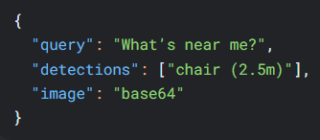
LLM RESPONSE MODULE
Purpose : To make the two way communication. It will get the detected object details and response according to the query asked by the user.
Technology : LLaVA-1.5-7B
Input :
Prompt Engineering:
System role: "You are a vision assistant... ….the detected objects and distances.."
Output :
“A chair is 2.5 meter away from you”

Slide 16
FEEDBACK MODULE
Purpose : Provide auditory feedback based on object detection and distance estimation of which is responded by LLM.
Components:
TTS: XTTS-v2 via FastAPI(/text_to_speech)
Wake Word: Porcupine SDK ("Jarvis") → Activates STT.
Key Features:
Announce the object name and its distance (e.g., “The chair is 5m away”).

Slide 17
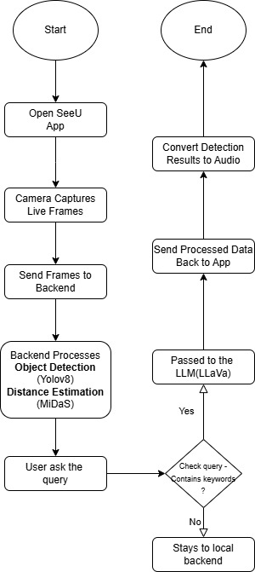
Flow Chart

Slide 18
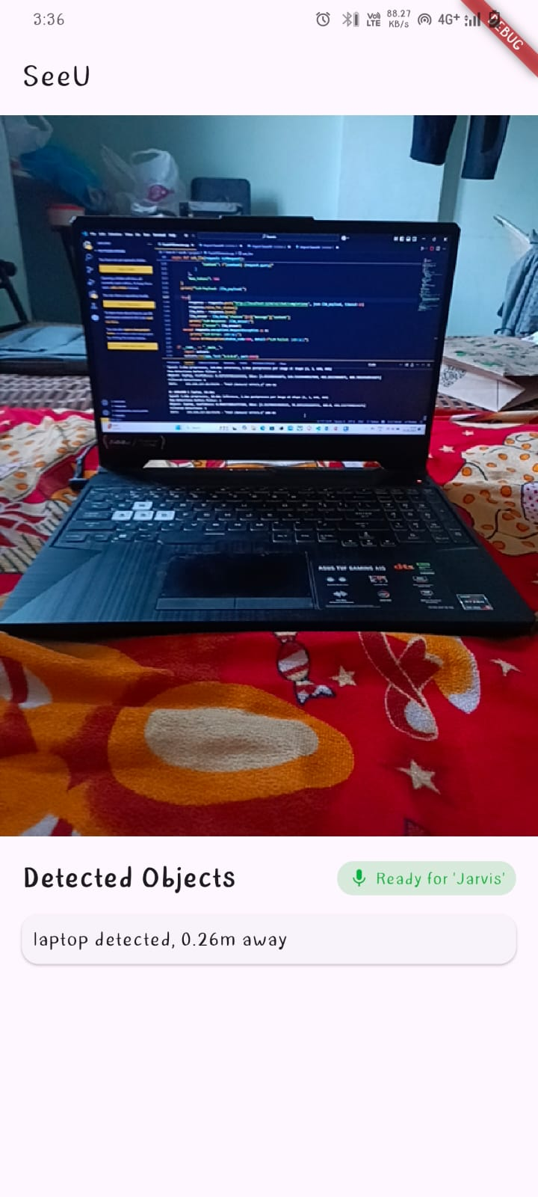
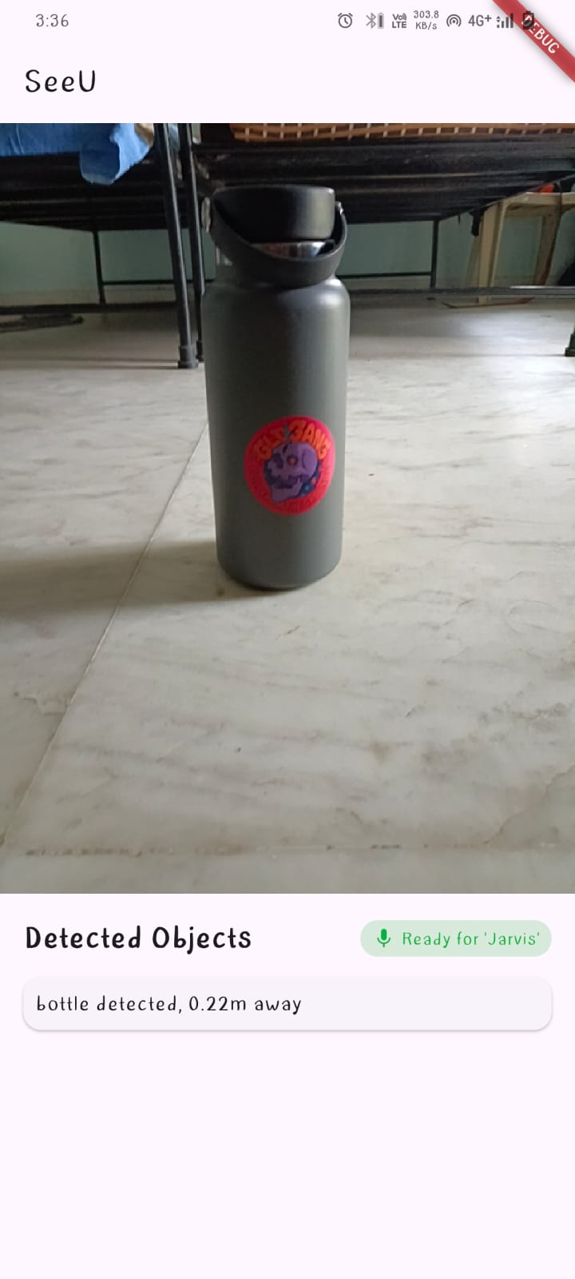
Implementation
Laptop Detected
Bottle Detected

Slide 19
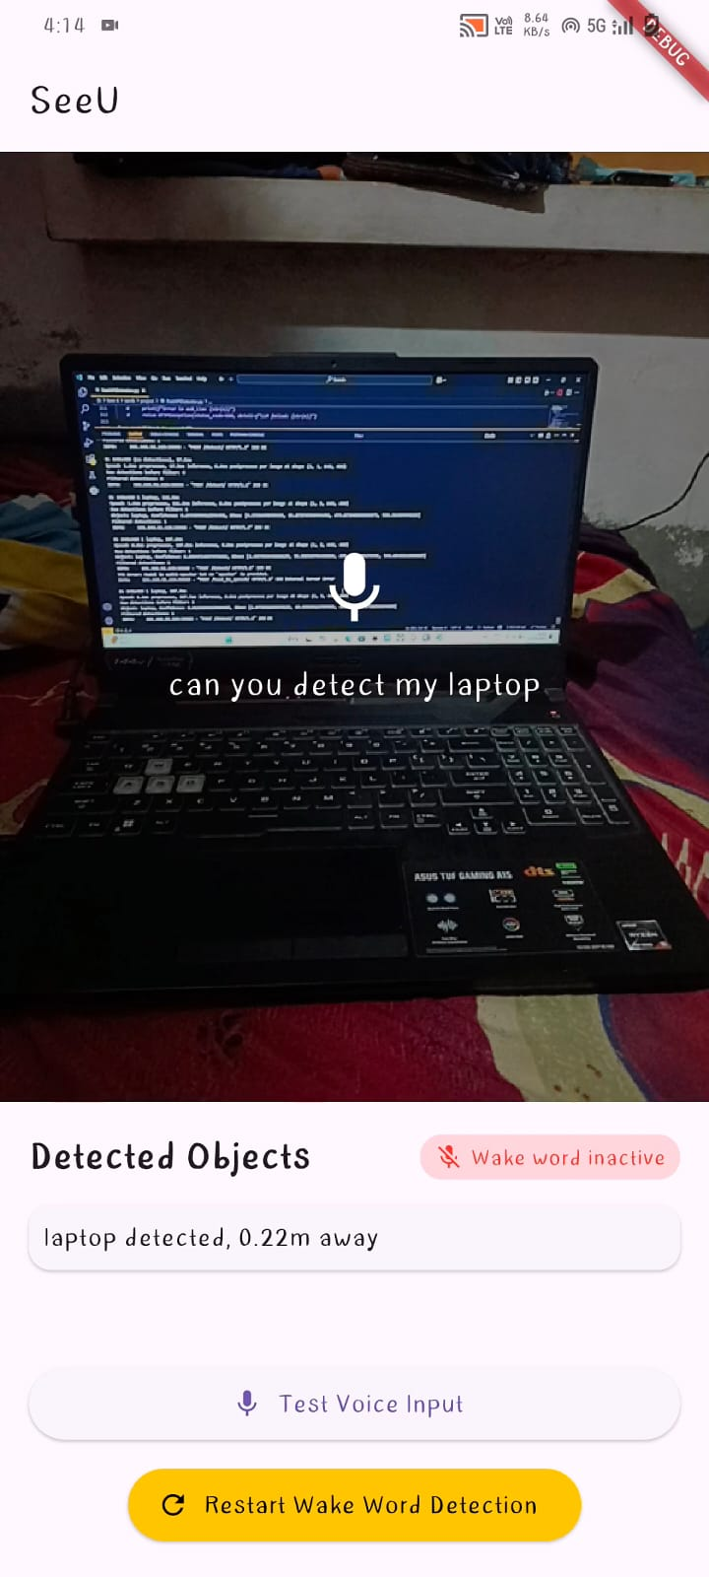
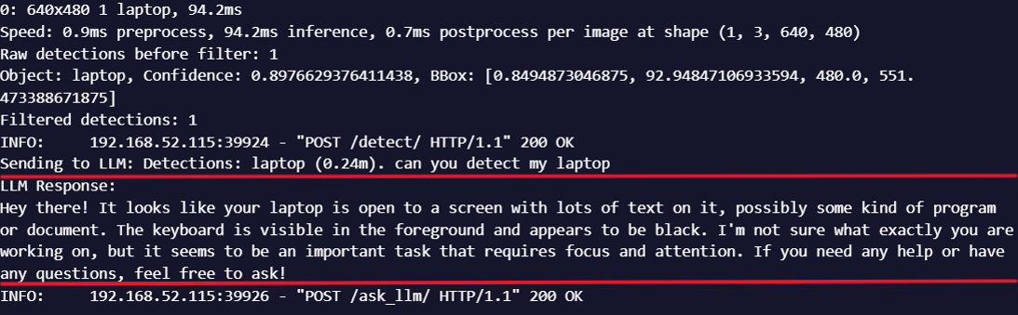
Implementation
This is the response we get from LLM
Query is asked

Slide 20
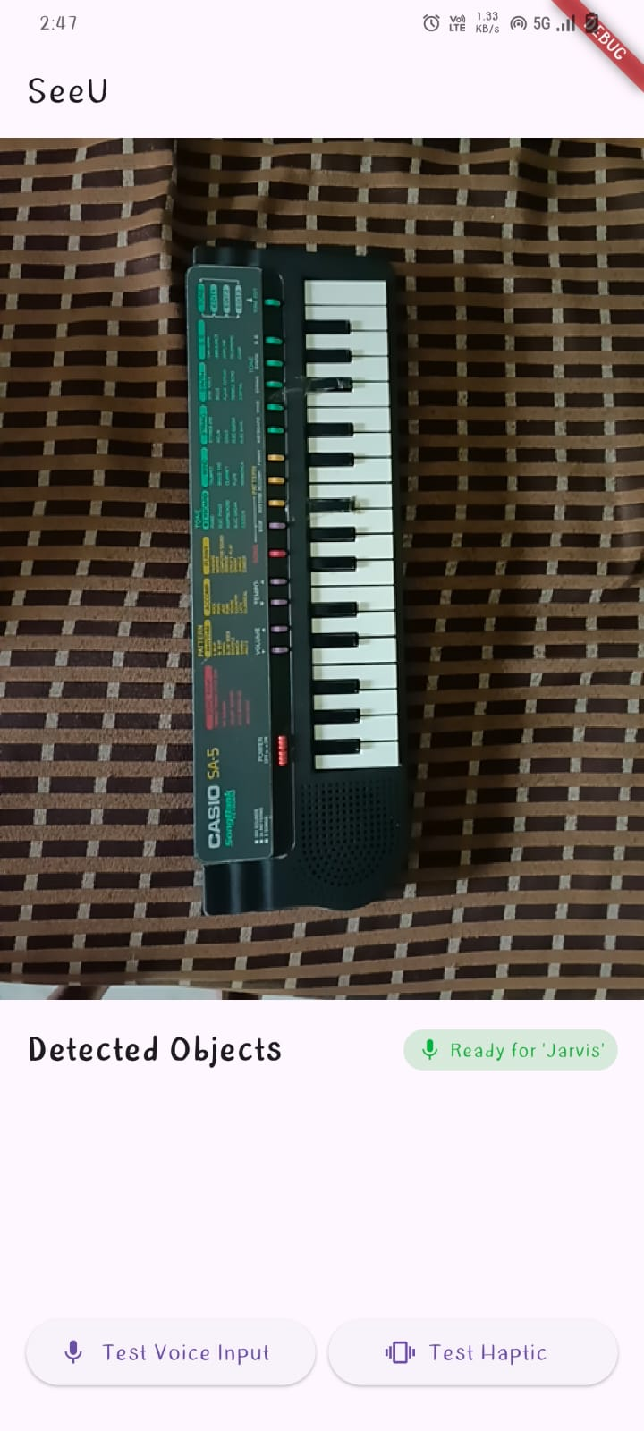
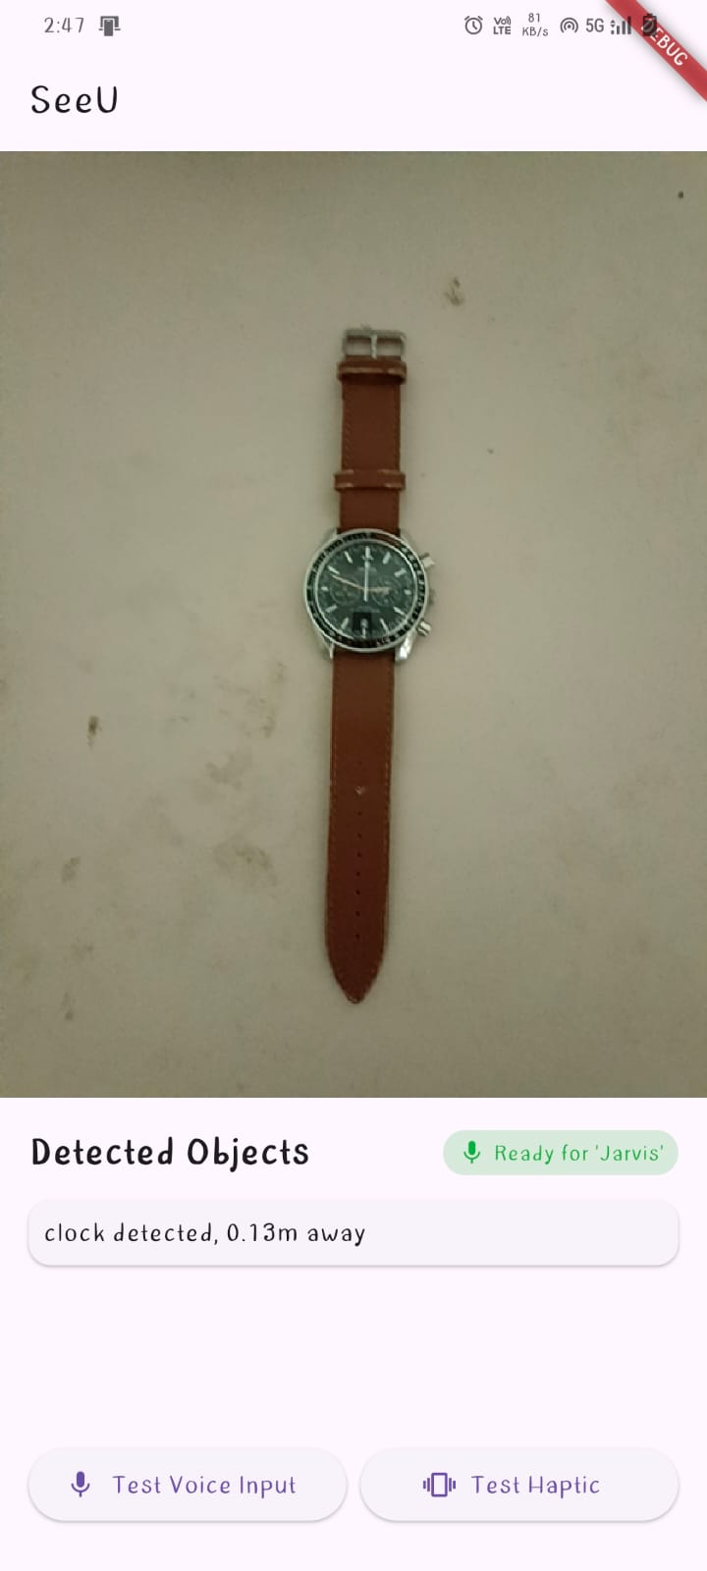
Object Detection Limitation
In 1st picture we can see that there is piano but my app is not detecting it. In 2nd picture we can see that it is detecting clock but it is actually a watch

Slide 21
CONCLUSION
My project SeeU: An Object Detection and Distance Estimation App for Assisting Visually Impaired Individuals successfully demonstrates the integration of deep learning, computer vision, and speech synthesis to provide real-time environmental feedback

Slide 22
FUTURE WORK
Contextual Awareness: Use LLM fine-tuning to describe object relationships (e.g., "Chair blocking the door").
Add other languages TTS support to serve regional users.
Integrate RNNoise to improve wake-word accuracy in noisy environments.

Slide 23
THANK
YOU

